Slide 1
ALGORITHMS
Mathematical Recipes (Baked Beans for beginners)

Slide 2
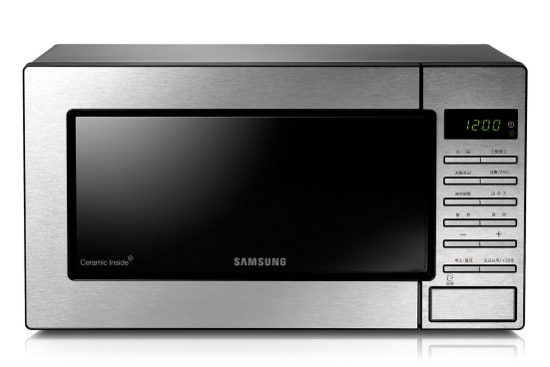





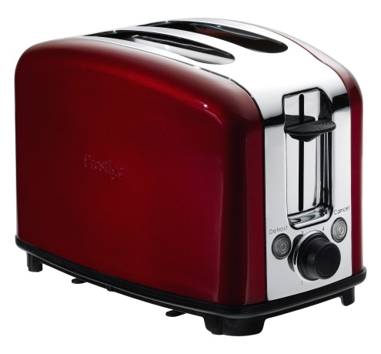


Beans on toast – A step by step approach ☺
What to do first ?

Slide 3
How would we produce an instruction sheet?
We need to identify each process
We need to look at the order of the processes
We need to identify any choices about which process to do next
We need to see if we have to repeat some processes more than once
We do this all the time in daily living

Slide 4



Simpler example - Coffee for beginners
Overall aim - Pouring a drink of coffee
Even a simple version needs the correct SEQUENCE ( order) of processes
+
=
+
=

Slide 5
Structure diagrams - Sequence
Title of Algorithm
Process 1
Process 2
Process 3
Process 4
Pour drink of coffee
Position mug
Pour from pot

Slide 6
Instructions for starting to write a Java program with Edit+
1
2
3
4
5
6
7
8
9
10
Click on Java
Put in password
Switch on power
Click on File
Click on Start
Press Ctrl Alt Del
Put in user id
Click on Edit+
Select New
Select Programs

Slide 7
Structure diagrams - Sequence
Java Programming
Switch on Power
Press Ctrl Alt Del
Put in user id
Put in password
Click on Start
Select Programs
Click on Edit+
Click on File
Select New
Click on Java
This is a very flat structure and does not group any actions together

Slide 8
Having a breakdown
Usually we start with a simplified view of the processes and then realise
that each one can be broken down or decomposed into sub processes.
The top level processes can describe in more detail which should
appear underneath in a structure diagram.
Title of Algorithm
Process 1
Process 2
Process 3
Process 4

Slide 9
Alternative and clearer structure
Starting to write a Java Program
Switch on power
Log on
Launch Edit+
Open a Java template
Click on Edit+
Click on Start
Select Programs
Press Ctrl Alt Del
Put in user id
Put in password
Click on File
Select New
Click on Java

Slide 10

Choice – mug or cup
Selection or choice is dependent on conditions
Are we very thirsty, (Is there enough coffee, have we any clean mugs…)
=
+
OR
OR

Slide 11
Structure diagrams - Selection°
Title of Algorithm
Condition
Process 2
Choice 2
Choice 1
Pour drink of coffee
Very thirsty?
Pour from pot
Position cup
Position mug
true
false
true
false
°
°
°
°

Slide 12
Multiple and Nested choices
In Java we often have multiple choices and sometimes they are nested
Complex examples can use the && and || constructions to show various paths through code
These can be clearer if you use a structure chart to see the possible choices

Slide 13
If I am thirsty I get some coffee. If I have coffee and it is before 11am I will have a biscuit.
This begins to sound like logic again so lets use
c: I have a coffee
b: I have a biscuit
Food and Drink
c
b
¬ b
¬ c
T
F
Note we may think of this as an incomplete specification as there are some unanswered questions e.g.
What happens if I don’t have coffee and its before 11am?
°
°
T
F
°
°
YDF 2015/16 Lecture 7 AMC

Slide 14
If I am thirsty I get some coffee. After that if it is before 11am I will have a biscuit.
This is subtly different but you can see that from a structure diagram
c: I have a coffee
b: I have a biscuit
Food and Drink
thirsty?
T
<11am
F
T
F
o
o
o
o
c
¬c
b
¬b

Slide 15
That’s enough!
Sometimes we will be repeating, iterating, a process while a condition holds or until a condition is met or for a fixed number of times
Here we might continue pouring
until the mug is full OR
while the cup is not full OR
for 5 seconds
+
=

Slide 16
Structure diagrams – Iteration*
Title of Algorithm
Condition
Condition
Choice 2
Choice 1
Process 2
Pour drink of coffee
Very thirsty?
Pour from pot
Position cup
Position mug
Until full
true
false
true
false
°
*
*
°
°
°

Slide 17
Which of the three basic structures are involved in these?
Getting dressed
Brushing teeth
Playing tennis
Beating cream
Swimming
Eating
Sunbathing
In a program simulating a Juke Box selection

Slide 18
Coping with idiots – full specification to cover all coffee possibilities
Where are the mugs?
Is the coffee in the pot?
Which cups shall I use?
How full is full?
What if I want a second cup?
What if the lid comes off the pot if I tip it!
What if the mug is dirty
What about the milk?
Can I put sugar in?

Slide 19
Formal and informal specification
If a system is particularly critical (people will die if the software fails or companies will lose billions if there are errors in the code) then capturing a correct specification is very important
All specifications start ‘informally’ when the client explains what they want
In the cases above, the specification is made more exact by using formal methods (based on sets and logic) so that there should be no ambiguity about the structure and behaviour of the system

Slide 20
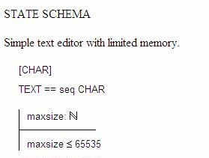
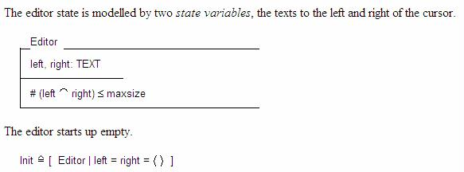
Thanks to Jonathan Jacky
http://staff.washington.edu/jon/z-lectures/schema.html
A b f r s e % j u s o n
left = A b f r
right = s e % j u s o n
Here #left = 4 and #right = 8
And the maximum number of characters possible is 65535

Slide 21
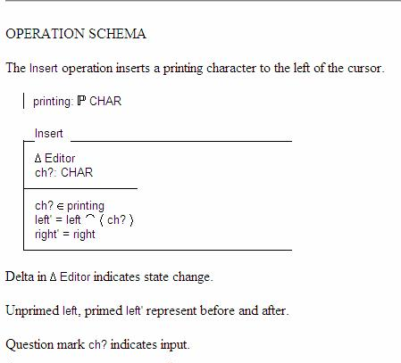
A b f r s e % j u s o n
ch? = e
A b f r e s e % j u s o n
left’ = A b f r e
right’ = s e % j u s o n

Slide 22
Tutorial - put these into a structure diagram which describes a typical Analytical Methods tutorial (add any missing ones)
H. Open bag
I. Ask for help
J. Read notes
Look at watch
Sign register
Talk to class mate
Arrive on time
A. Do next question
B. Leave after an hour
C. Choose pen or pencil
D. Open pad
E. Open tutorial book
F. Look at watch
G. Talk to class mate

Slide 23
Back to the Beans on toast - identify the processes & put them in order

Slide 24
One possible solution
Put bread in toaster
Open can of beans
Put beans in mug
Put mug in microwave
Turn on microwave 2 mins
Take toast out of toaster
Place toast on plate
Butter toast
Stir beans
Put mug back for further 2 mins
Get knife and fork ready
Pour beans over buttered toast

Slide 25
Algorithms – Instruction sets
Definition
An algorithm may be defined as a
sequence of instructions to solve a
problem which has the following
properties:
The algorithm receives INPUT
The algorithm produces OUTPUT
The algorithm stops after a FINITE set of instructions have been executed
Each instruction in the algorithm is followed by a UNIQUE SUCCESSOR instruction.

Slide 26
Unique successor can depend on the input
OR
IF coffee THEN sober
ELSE IF beer THEN drunk

Slide 27
Multiply
READ x,y
n ← 0
Answer ← 0
DO
Answer ← Answer + y
n ← n+1
LOOP UNTIL n =x
DISPLAY Answer
End Multiply
Naming the algorithm
Taking in inputs x and y
Initialising the loop counter, n
Initialising the value of Answer
Start of loop
Updating Answer each time
Updating the counter
Finishing the loop
Outputting the result
Ending the algorithm
Multiply
Until n=x
DISPLAY Answer
READ x,y
n ← 0
Answer ← 0
Do
*
Answer ← Answer + y
n ← n+1

Slide 28
Keeping tables of values (iteration)
Multiply
Until n=x
DISPLAY Answer
READ x,y
n ← 0
Answer ← 0
Do
*
Let x = 5 y = 7
Answer ← Answer + y
n ← n+1
 | x | y | Answer | n | Test n=x
Start | 5 | 7 | 0 | 0 | false
Do 1 |  |  | 0+7=7 | 0+1=1 | false
Do 2 |  |  | 7+7=14 | 1+1=2 | false
Do 3 |  |  | 14+7=21 | 2+1=3 | false
Do 4 |  |  | 21+7=28 | 3+1=4 | false
Do 5 |  |  | 28+7=35 | 4+1=5 | true

Slide 29
Multiply
READ x,y
n ← 0
Answer ← 0
DO
Answer ← Answer + y
n ← n+1
LOOP UNTIL n =x
DISPLAY Answer
End Multiply
This is pseudo code
Halfway between natural language and coding into a programming language
It can be useful for clarifying your thoughts about the structure of your program before you start writing code
You should be able to ‘translate’ ideas into pseudocode
You should also be able to ‘translate’ between a structure chart and pseudo code and explain both

Slide 30
Addition
READ x,y,z
Answer ← x+y+z
DISPLAY Answer
End Addition
Naming the algorithm
Taking in inputs x,y and z
Assigning to Answer the sum of
x, y and z
Outputting the result
Ending the algorithm
Addition
READ x,y,z
Answer ← x+y+z
DISPLAY Answer

Slide 31
Download
READ song, myTunes
IF
song ∈ myTunes
message ←Got it
ELSE
myTunes ←myTunes song
message ←song added
DISPLAY message
End Download
Naming the algorithm
Taking in song and myTunes
Start of conditional
Test if already got song
Assigning statement to message if true
If test false
Updating myTunes with song
Assigning statement to message
Displaying message
Ending the algorithm
Download
READ song, myTunes
song myTunes
DISPLAY message
T
F
o
message ← Got it
myTunes ← myTunes song
message ← song added
31

Slide 32
Example algorithm for checking valid student id
Typical id ph203
5 characters
2 letters followed by 3 numbers
Read in 1 character at a time
Give error message when it is clearly not a student id
Try the structure diagram (it is quite complex)

Slide 33
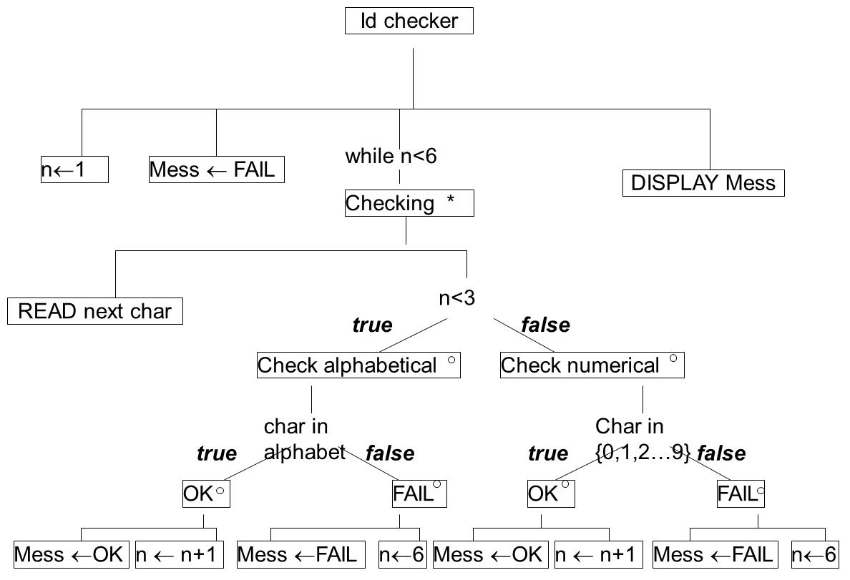

Slide 34
Id Checker
n ← 1
Mess ← FAIL
WHILE n<6
READ char
IF n<3 THEN
IF char in alphabet THEN
Mess← OK
n ← n+1
ELSE
Mess← FAIL
n ← 6
ENDIF
ELSE
IF char in {0,1,2…} THEN
Mess← OK
n ← n+1
ELSE
Mess← FAIL
n ← 6
ENDIF
ENDIF
ENDWHILE
DISPLAY Mess
End Id Checker
This is only one suggestion, other algorithms will meet the specification
Note the first failure
Jumps out of the checking process by pushing the loop counter to the end
Not elegant but effective!

Slide 35
You can match the shape of the algorithm with the structure chart

Slide 36
3 main structures
Sequence
doing the operations in order one after the next
Selection
having a choice of the next operation dependant on some condition which will be true or false
Iteration
having an operation repeated until some condition is false or while a condition is true

Slide 37
Sequence
Double
Read n
n ← 2*n
Display n

Slide 38
Selection
Age
READ n
n < 0 or n>180
DISPLAY
“Error – bad input“
DISPLAY
“Age is” n
True
False
°
°

Slide 39
Iteration
Multiply
until n=x
READ x,y
n ← 0
Answer ← 0
DISPLAY Answer
Do
*
Answer ← Answer + y
x←x + 1

Slide 40
Nesting can be difficult
Algorithm
READ ←r,s,t
i ←0
j ←0
IF r>s
DO
s = s-4
i = i+1
IF s>t
DO
t = t+3
j= j+1
LOOP UNTIL j = s
ENDIF
LOOP UNTIL i = r
ENDIF
DISPLAY r, s, t
End Algorithm

Slide 41
Indenting helps
Algorithm
READ ←r,s,t
i ←0
j ←0
IF r>s
DO
s = s-4
i = i+1
IF s>t
DO
t = t+3
j= j+1
LOOP UNTIL j = s
ENDIF
LOOP UNTIL i = r
ENDIF
DISPLAY r, s, t
End Algorithm

Slide 42
Object oriented programming
Structure charts were designed to work best with procedural programming
They can be adapted for OO programs but you will probably use integrated design and specification tools which will incorporate class diagrams sequence diagrams and use case etc
The design tool is not important, it is being able to think at the structural level about the algorithms and processes of your systems

